Slide 1
Advancing Equity and Inclusion
NCDA Annual Conference
June 22-24, 2022

Slide 2
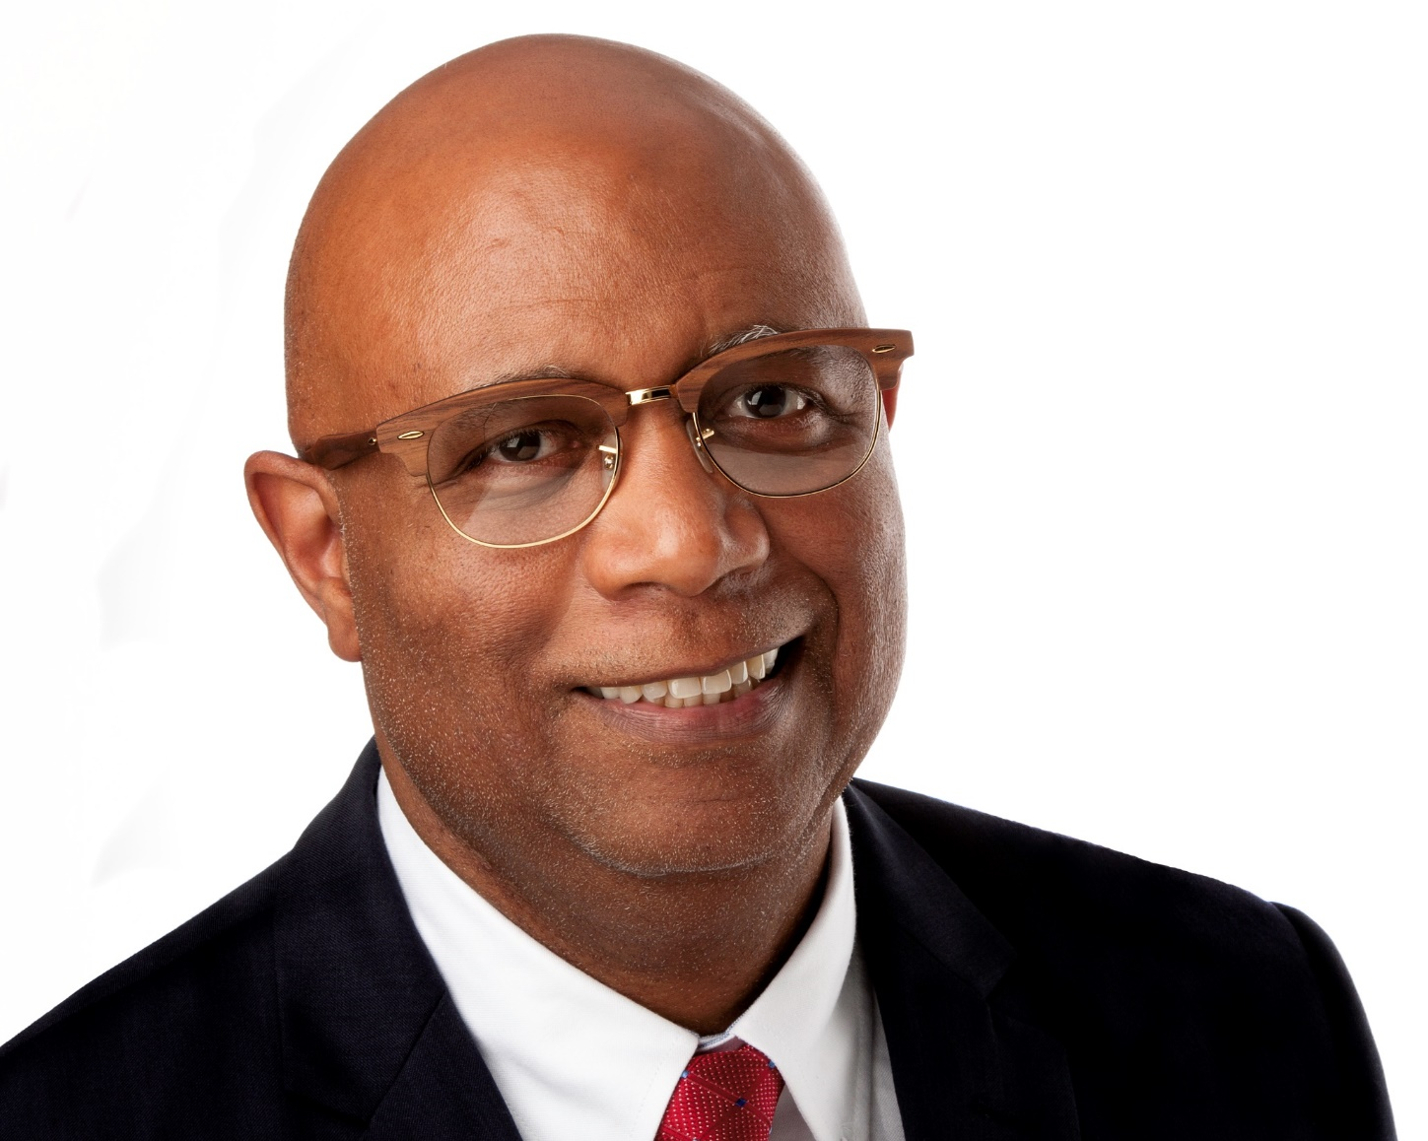
Moderator
Rollin Seward
Community Development Director
City of Canton, OH
rollin.seward@cantonohio.gov

Slide 3
Rollin E. Seward
Community Development Director, City of Canton, OH
“The Pro Football Hall of Fame City”
37 Years of Community Development Experience with HUD Programs
Worked with City, County and State Government
NCDA Board Member
Ohio Conference of Community Development Board Member
Chairman- 2014 NCDA Summer Conference

Slide 4
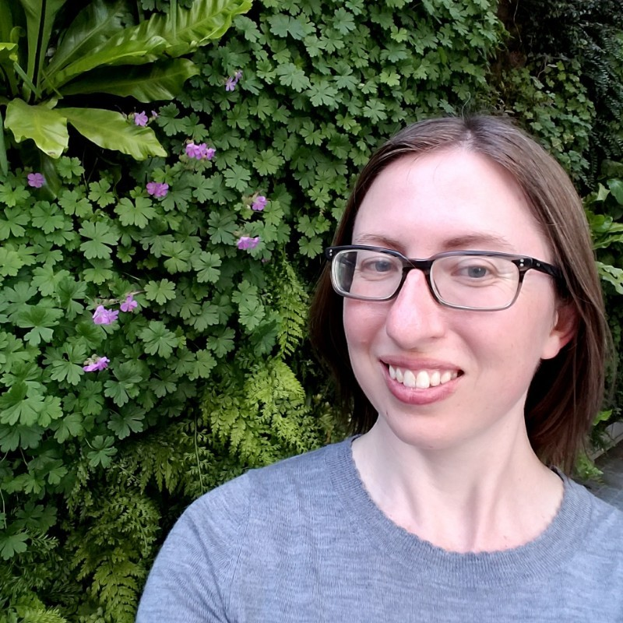
Presenter
Roxanne Kimball
Residential and Real Estate Development Manager
Office of Community Planning and Economic Development
City of Minneapolis, MN
Roxanne.Kimball@minneapolismn.gov

Slide 5
Roxanne Kimball
Residential and Real Estate Development Manager, City of Minneapolis, MN
15 years experience in Community Development, including East Side Neighborhood Development Company, Riverview Economic Development Association, and the City of St. Paul.
Certified Housing Development Finance Professional
Certified Economic Development Finance Professional
LEED Green Associate
Licensed Mortgage Originator

Slide 6
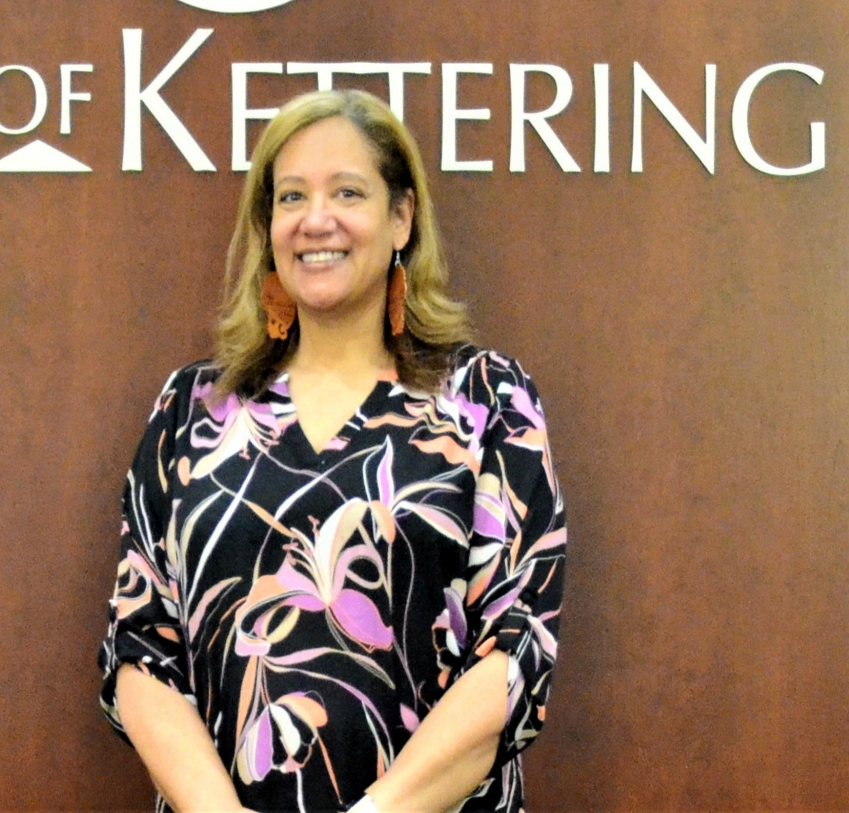
Presenter
Angela Rahman
Community Development Manager
Planning and Development
City of Kettering, OH
Angela.Rahman@ketteringoh.org

Slide 7
Angela Rahman
Community Development Manager, City of Kettering, OH
Certified Housing Development Finance Professional- National Development Council
Former 2x President- Ohio Conference of Community Development
Chairman- HomeOwnership Center of Greater Dayton
Miami Valley Fair Housing Center- Board Member
Mental Health Recovery Boards of Warren and Clinton Counties- Board Member
NCDA Board Member

Slide 8
